Slide 1
Today we are going to learn a song

Slide 2
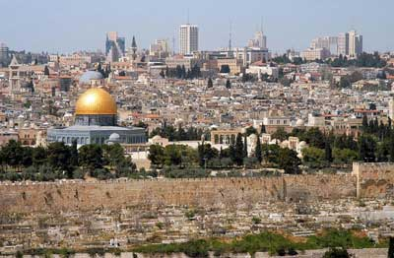
The song is about…

Slide 3
The song is about…

Slide 4
The song is about…

Slide 5
Is the song about…

Slide 6
Is the song about…

Slide 7
Is the song about…

Slide 8
Jerusalem- Yerushalim

Slide 9
Jerusalem New Words
tears-
Western Wall-
pray-
best-
forever-
years-
place-

Slide 10
New words- worksheet
Link- Jerusalem song

Slide 11
Jerusalem song
There is a _________, Yerushalaim
That we love ___________, Yerushalim
City of our dreams, city of _________
We cry for you for so many years!
Ho, Yerushalaim! Ho, Yerushalaim!
You are our home. Yerushalaim!
The _______ ________ - in Yerushalim
Come one come all
To Yerushalaim,
Ask Hashem for his help
So we can come together
Back to our home
And this time- ___________!

Slide 12
Jerusalem New Words
tears-
Western Wall-
pray-
best-
forever-
years-
place-

Slide 13
Home work:
שכפול- עבודות 2,3
Have a nice day ☺

