Slide 1
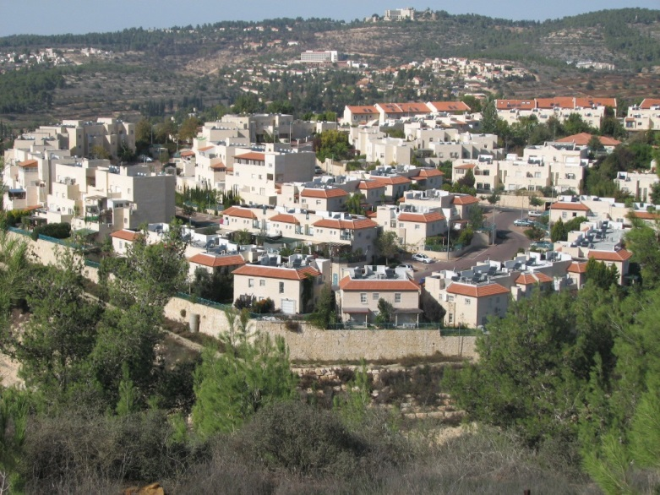
Neighborhood (n.)
In the neighborhood we have…
Many houses
Many horses

Slide 2
prize (n.)
I get a prize when …
I’m having fun
I’m arguing
I’m wining.

Slide 3
Poet (n.)
A poet is someone who…
Bakes potatoes and plums
Writes poems and songs
Paints pictures

Slide 4
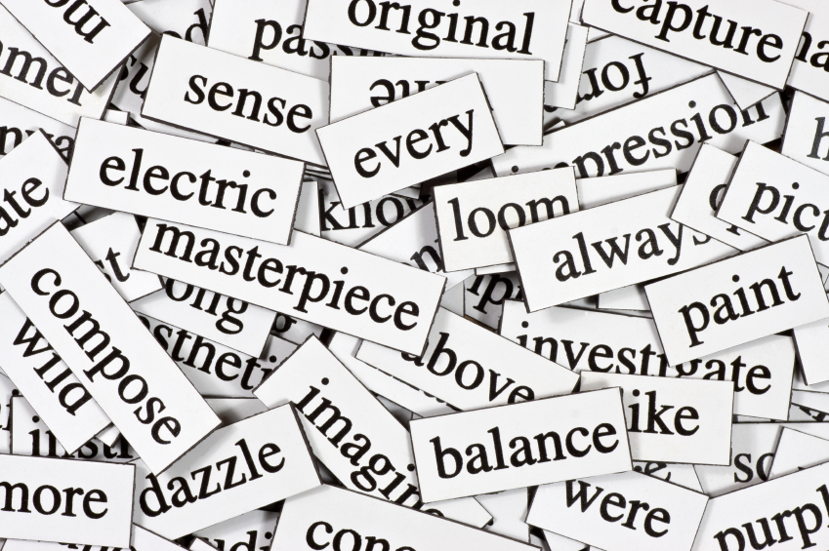
Words (n.)
I use words when…
I want to drink a coffee
I want to swim
I want to explain something

Slide 5
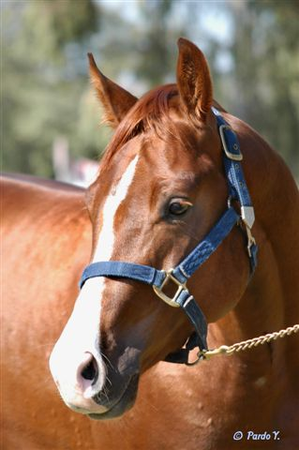
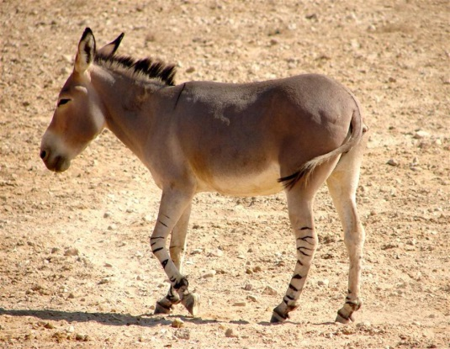
Horse and donkey (n.)
Horse and donkey are:
famous artists
Farm animals
Huge cities

Slide 6
Complete the sentence:
You are number 1. you are….
My telephon
The first
The last

Slide 7
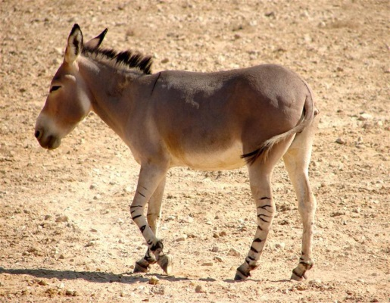
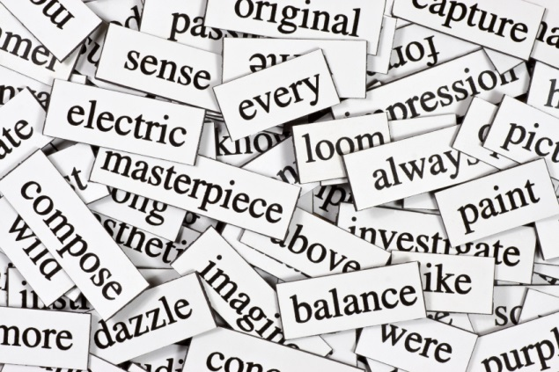
Now say together:

